Slide 1
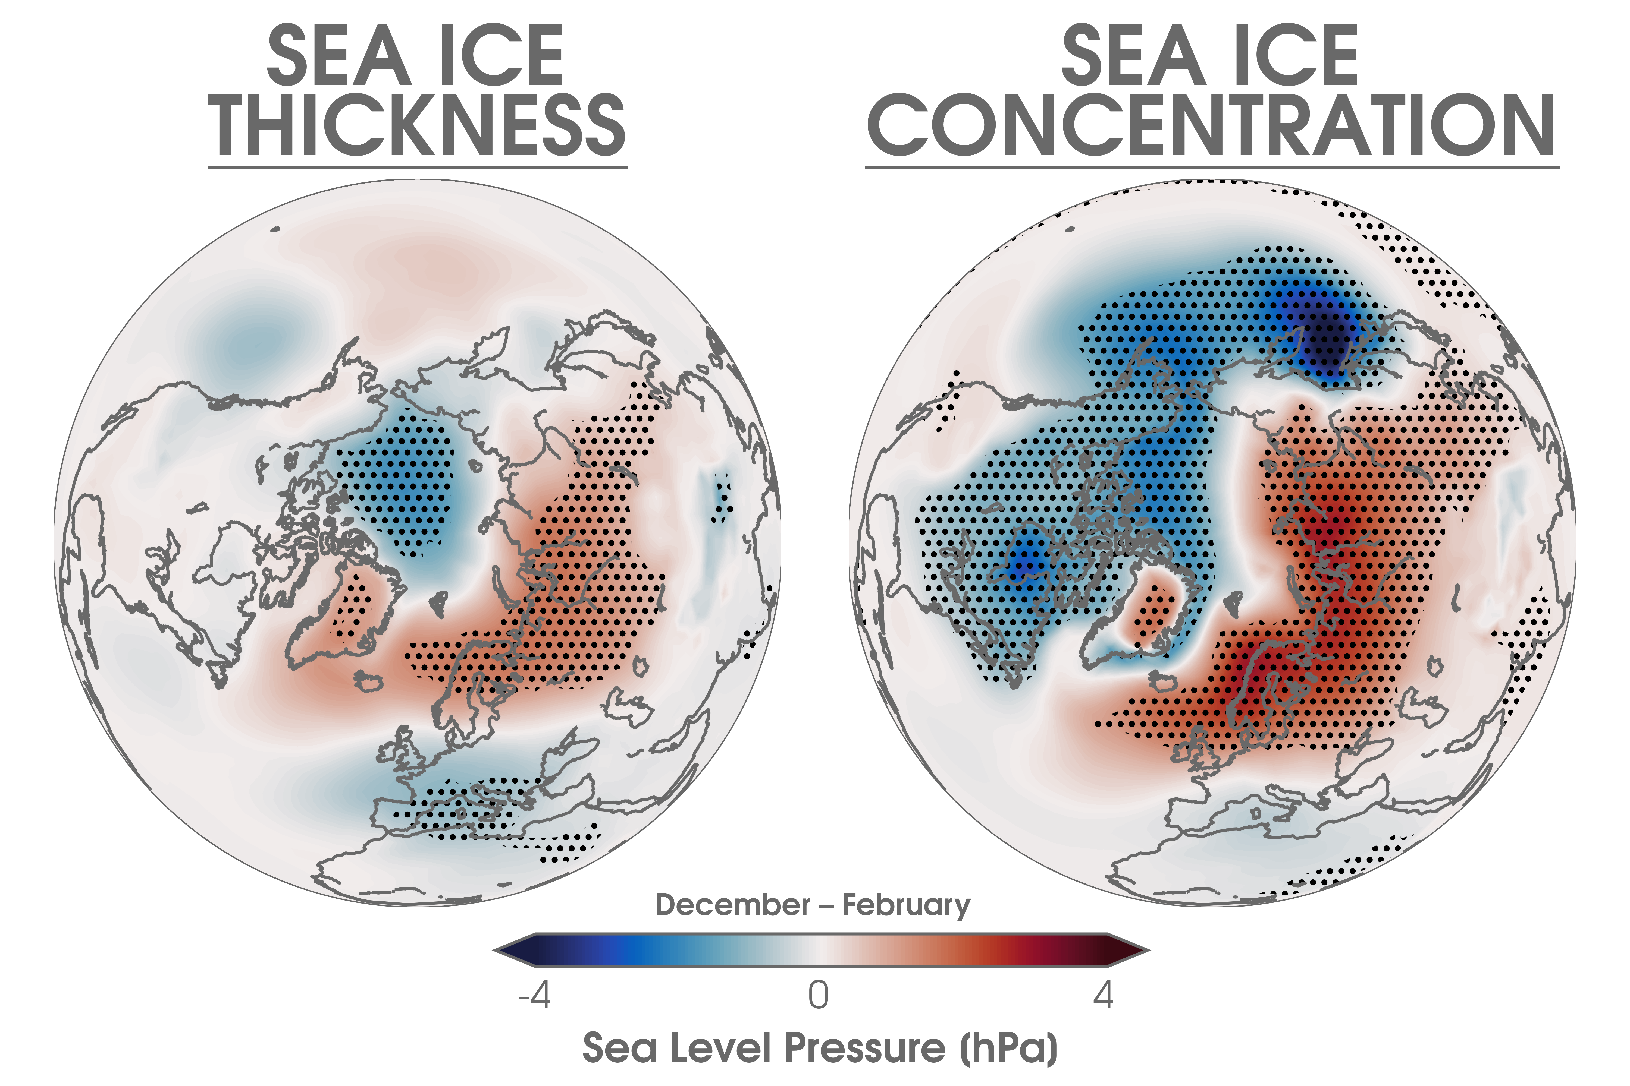
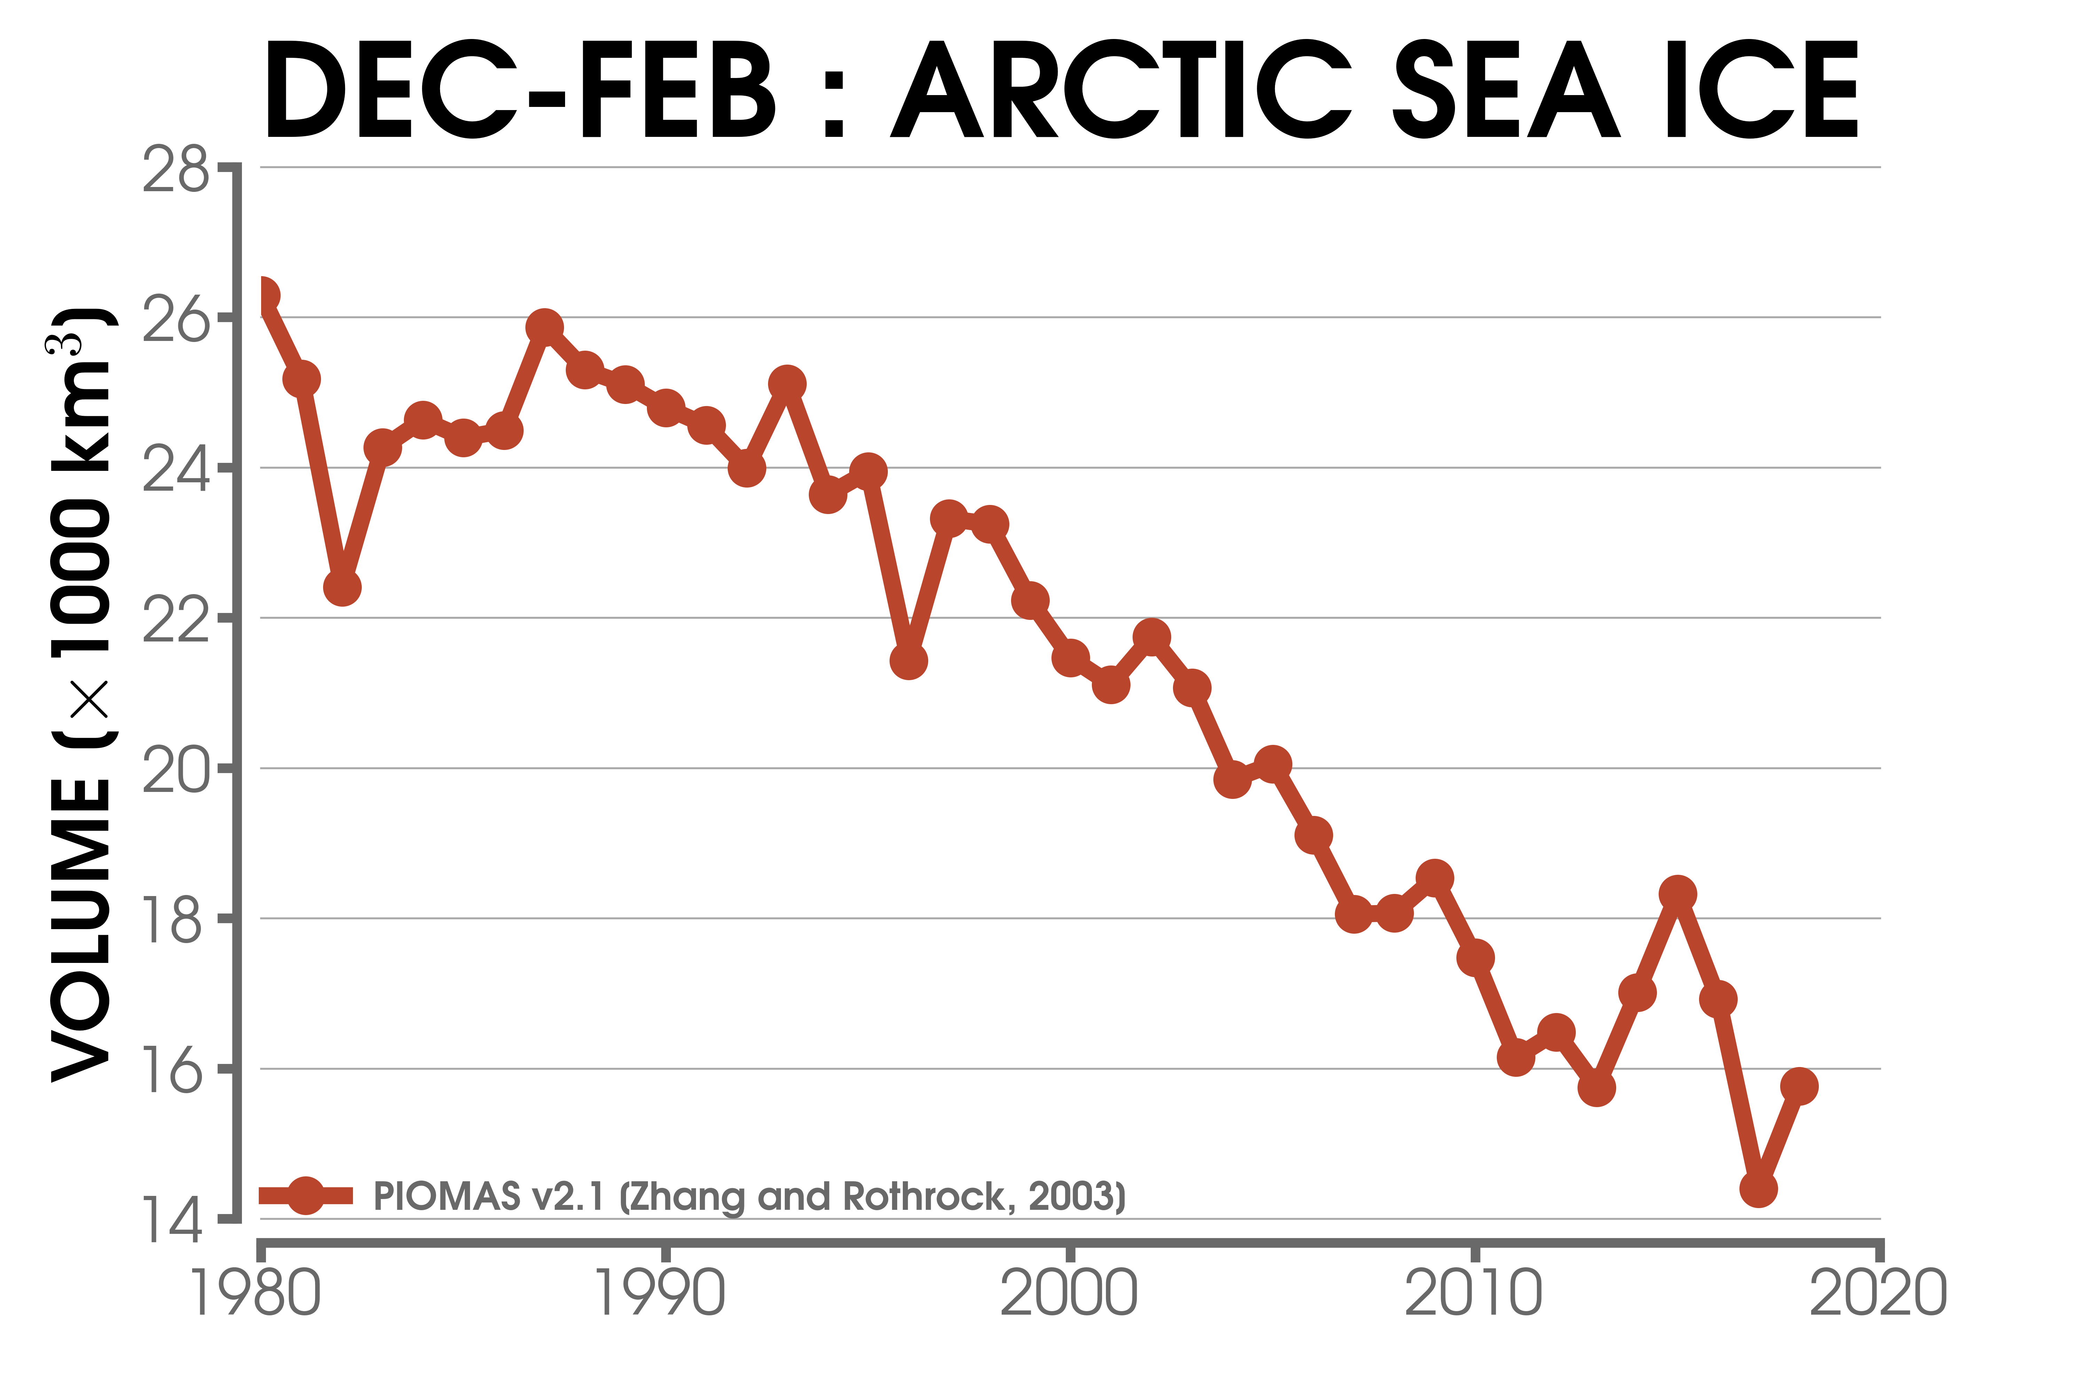

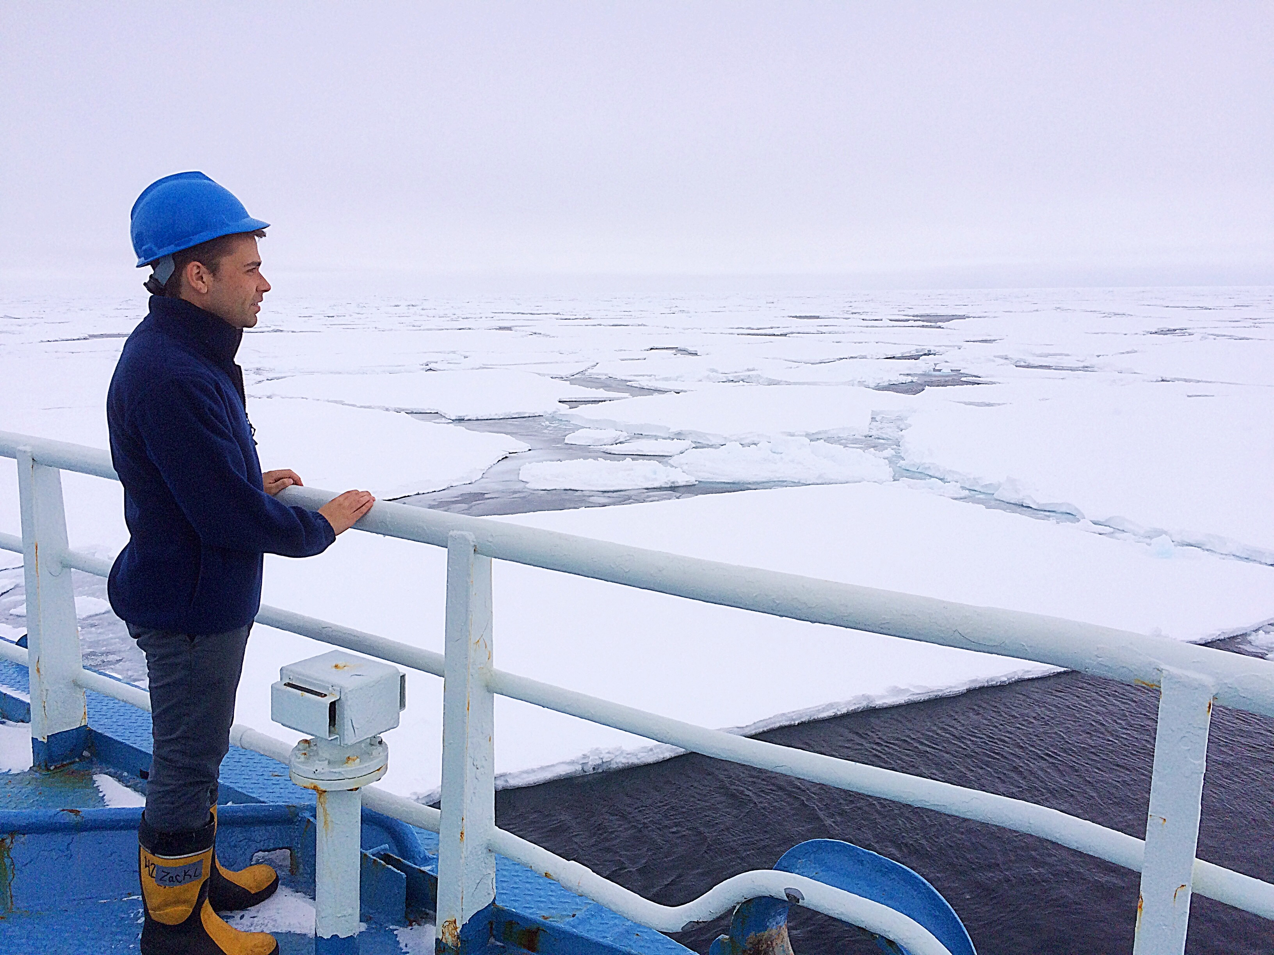


LOSS OF ARCTIC SEA ICE THICKNESS AFFECTS THE
LARGE-SCALE ATMOSPHERE
The thinning of Arctic sea ice contributes to a
large-scale atmospheric response from projected
21st century sea ice loss. Compared with sea ice
concentration, sea ice thickness further enhances
the surface thermodynamic and troposphere
circulation anomalies. Changes in sea ice
thickness should be considered when assessing
Arctic and mid-latitude connections.
ZACHARY M. LABE
Department of Earth System Science
University of California, Irvine
CONTACT: zlabe@uci.edu
@ZLabe

